Slide 1
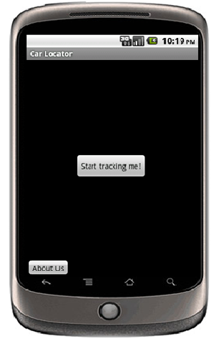
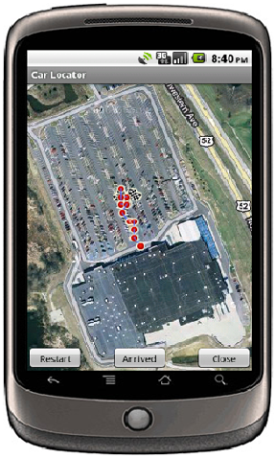
VI – Smartphone Team
Never lose your way around parking lots again.
Use the Car Locator!
Muhammad Aizuddin Zulkifli
Ahmad Mujahid Mohd Razip
Vinayak Gokhale
Prof. Jan P. Allebach
Prof. Edward J. Delp

