Slide 1
Week 10
Car Locator
(Ahmad, Din, Vinayak)

Slide 2
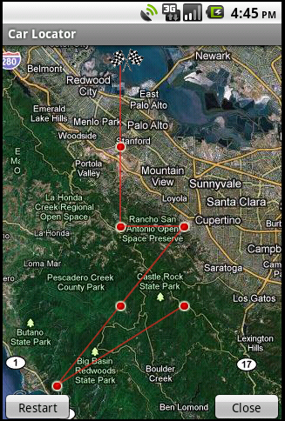
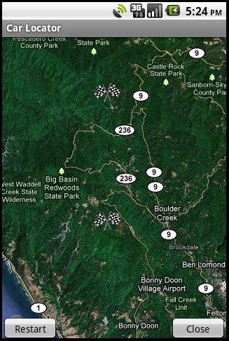
Paths
Starting point : where you want to go back to
Intermediate points
Din: Created lines
Ahmad: Debug and markers

Slide 3
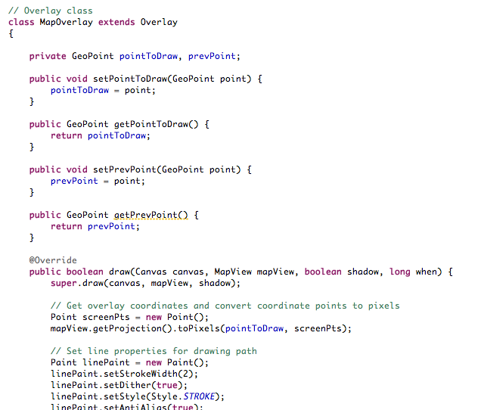
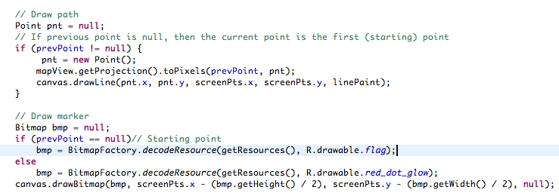
Need two points to draw a line
Identify starting point

Slide 4
Added new screen
Added a different screen for the return path
Application now closes completely when the “Close” button is pressed.
Added a Vibrator (sic).

Slide 5
Close class
Made a new class/activity known as “close”.
The class is called every time the “Close” button on MapScreen is pressed.

Slide 6
Changes
The trick is to leave no activity open. Once a new activity is started, close
the calling activity
This also helps save power as multiple activities are not open at once
Exit(0) is a bad idea since it deletes all tracking variables (first_time, clse, etc.)

Slide 7
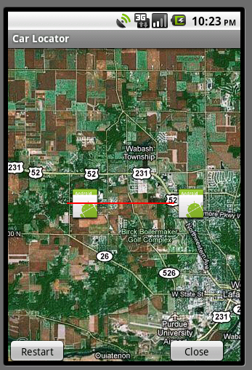
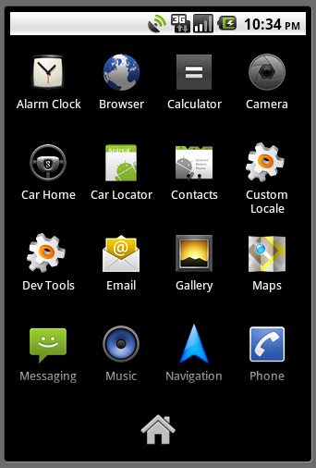
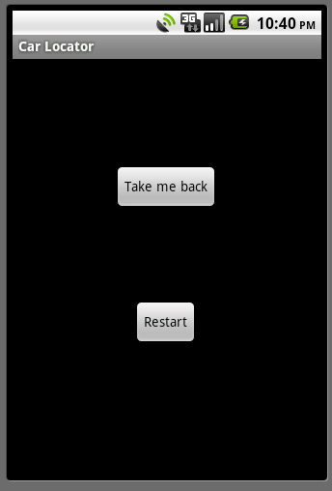
Pictorial Demo
Note: While the vibrator (sic) has been implemented and does indeed show up in logcat, it cannot be shown on the emulator.
Also, there have been known issues with implementing the vibrator (sic) on the emulator.
Created by Vinayak

Slide 8
Next Week
Debug lines
Different colored lines to- and from- path

