Slide 1
Week 11
Car Locator
Ahmad, Din, Vinayak

Slide 2
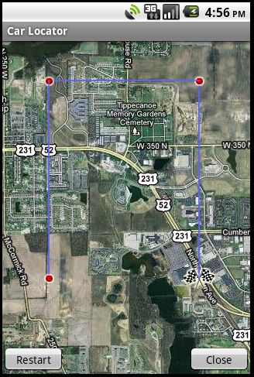
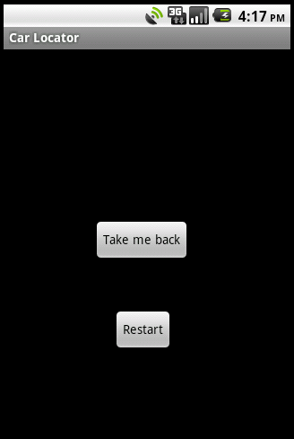
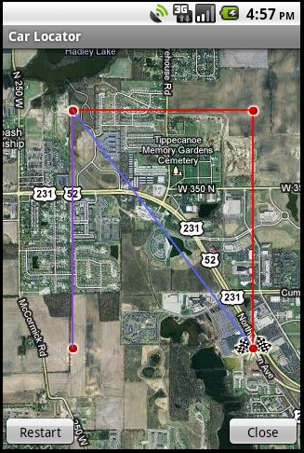
To and From Paths
Changed the colors of the two paths.

Slide 3
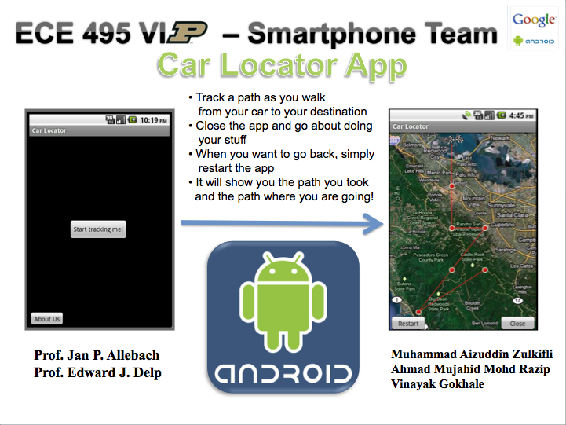
Made poster!
https://engineering.purdue.edu/~vipfor/fall2010/CarLocator/CL_Poster.pptx

Slide 4
Next week
Remove the line connecting the last point of the “To” path and the first point of the “From” point.
Test the app on a real phone (Also pronounced: Professors, could you please buy the phone?)

