Slide 1
Car Locator
Week 12

Slide 2
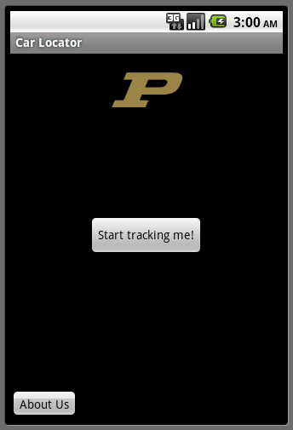
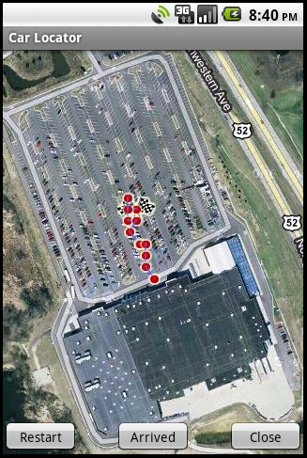
Where we were

Slide 3
What changes were made
Changed the color of the “to” and the “from” path (Ahmad)
Removed the line joining the final and initial points (Ahmad)
Added pop-up windows (Mostly Din, a little - Vinayak)
Added an “Arrived” button and its associated pop-up (Vinayak)

Slide 4
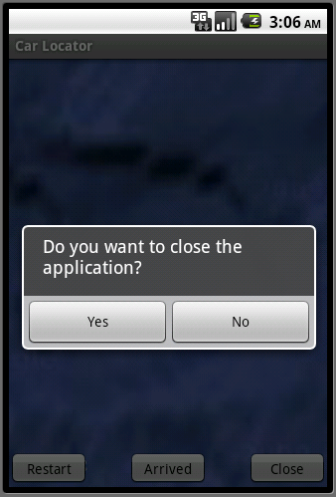
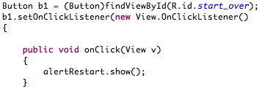
Pop-up windows

Slide 5
Next week
The last point before the app is closed and the first point when it
is restarted are still joining.
Remove old, commented stuff.
Try installing the app on the phone (also read, “We need a phone!”)
Fancy stuff?

