Slide 1
Week 13
CarLocator
Ahmad, Din, Vinayak

Slide 2
Start app
Extract image from GM and save starting location coordinates
Get location periodically (2s)
Ask the user to/automatically shut down the app after saving the map after a certain time
Display saved image when app restarts and start updating current position periodically with a different color
On OK, delete saved picture
On arriving at destination, display an appropriate message
END

Slide 3
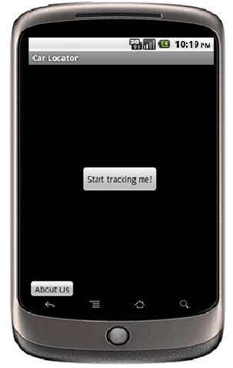
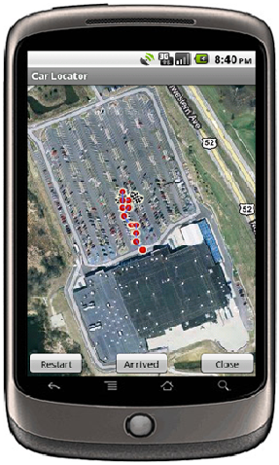
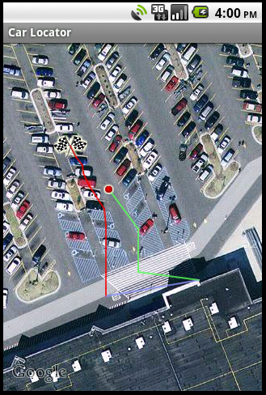
VI – Smartphone Team
Never lose your way around parking lots again.
Use the Car Locator!
Muhammad Aizuddin Zulkifli
Ahmad Mujahid Mohd Razip
Vinayak Gokhale
Prof. Jan P. Allebach
Prof. Edward J. Delp

Slide 4
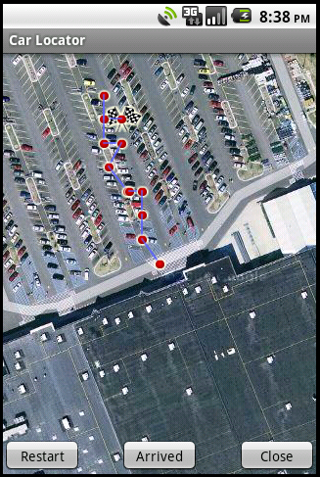
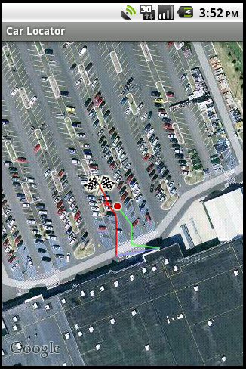
Changes made
Separated the to-path and return-path
Have only one dot to mark current location
Changes done by Ahmad

Slide 5
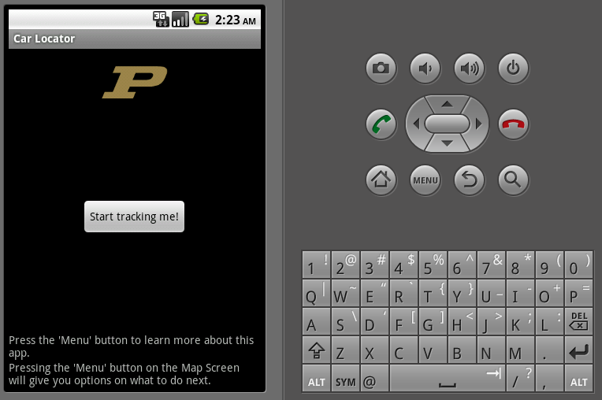
Changes made (Contd…)
There were too many buttons to display on some activities
Added menus to organize the buttons

Slide 6
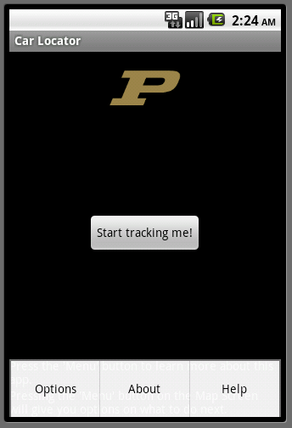
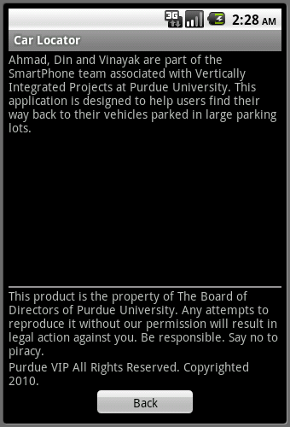
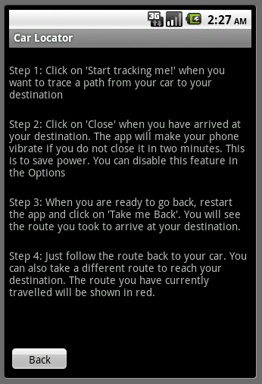
Changes made (Contd…)
These were added by Vinayak

Slide 7
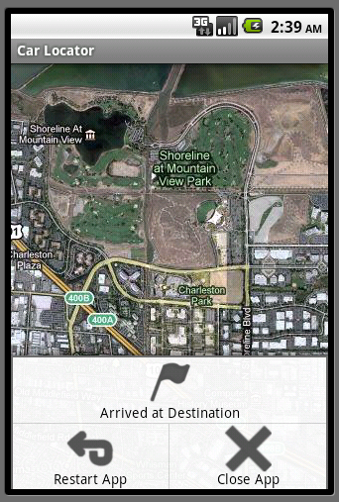
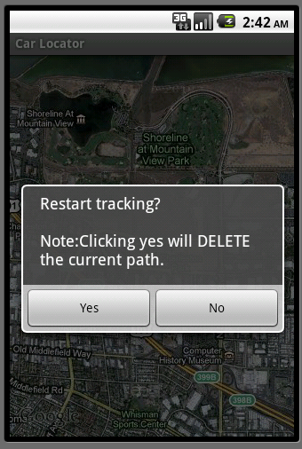
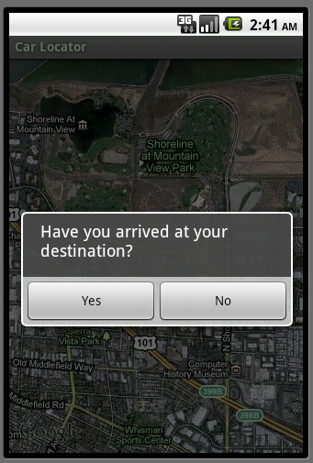
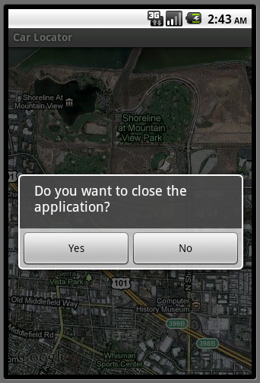
Changes made (Contd…again)
These were added by Din

Slide 8
Next Week
Add items to the “Options” screen
Enable the user to turn off anti-aliasing or color of line
Enable the user to use different types of map terrain
Enable the user to choose whether to let the phone vibrate or not
Enable the user to change the icon of the final destination
Etc.
Etc.

