Slide 1
Car Locator
Week 14
Ahmad, Din, Vinayak

Slide 2
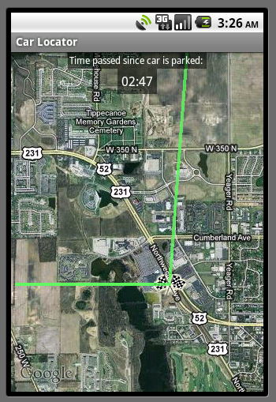
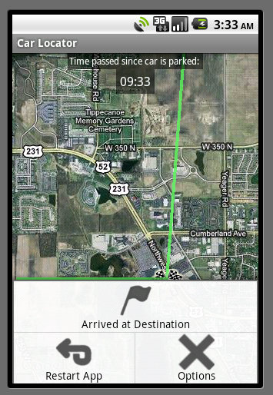
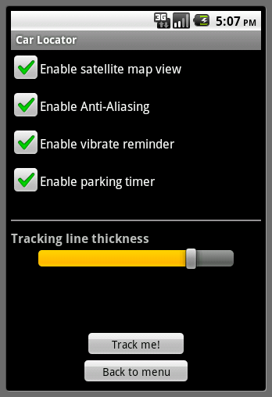
Increased functionality
Added stuff to the “Options” menu.

Slide 3
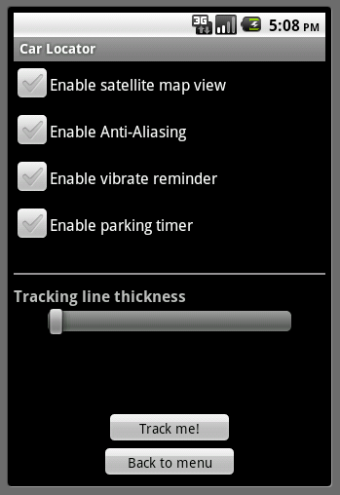
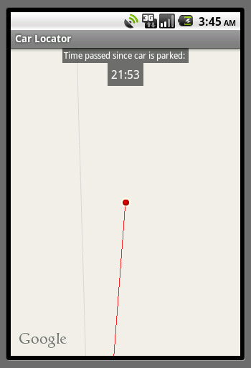
Functionality (contd…)
Also, now coordinates are logged every 5 meters instead of every 2 seconds.

Slide 4
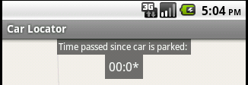
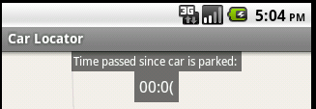
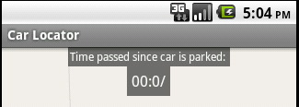
Problems
Uses SystemClock class: system “on” time.
Problem when rebooting
Solution: Assume user does not reboot phone (or run out of battery) when running this app.

