Slide 1
Weekly Presentation
Week 5

Slide 2
Developments
Completed the user interface for the first layer
Added an “About Us” button.
Ran into an error because the Android Manifest was not updated when an intent was created and called.

Slide 3
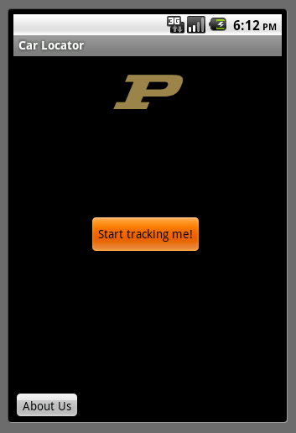
UI

Slide 4
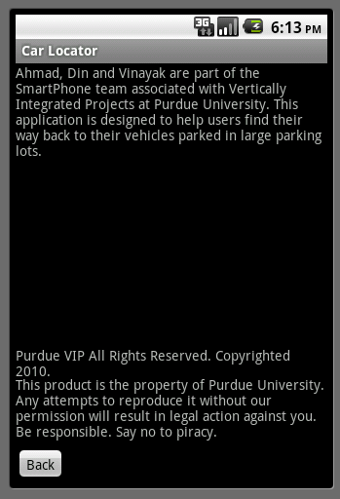
Buttons

Slide 5
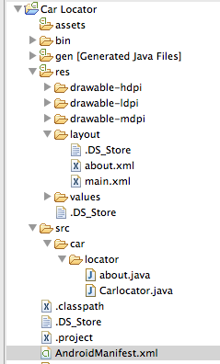
Android Manifest

