Slide 1
Car Locator
Week 6

Slide 2
Google Static Map API
Free to use (API key isn’t even needed)
Flexible – can add markers and/or paths
Sample:
http://maps.google.com/maps/api/staticmap?center=Purdue+Mall&zoom=16&size=512x512&maptype=roadmap&sensor=true

Slide 3
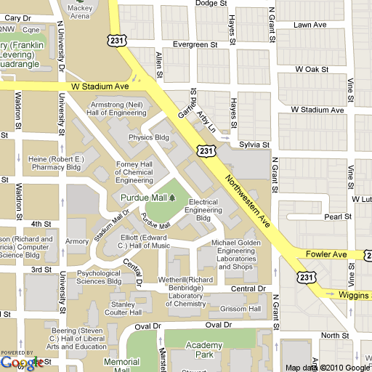
Resulting Image

Slide 4
<need to put code into android project and get a screenshot here>

Slide 5
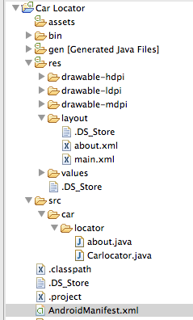
Android Manifest - permissions
Initially could not figure out why image would not load in simulator.

