Slide 1
Week 7
Car Locator

Slide 2
GPS updates dynamically
Added the LocationListener interface to acquire the GPS data.
Added the LocationManager class to implement the following methods –
requestLocationUpdates – Takes arguments minTime and minDistance (amongst others – unimportant).
getLastKnownLocation – Gives the last known GPS coordinates received (or “listened” to by the listener).
Notice (amongst the other hidden and currently unimportant comments) the note in the above comment
Have the main activity implement the listener as it is going to be used by the entire layer

Slide 3
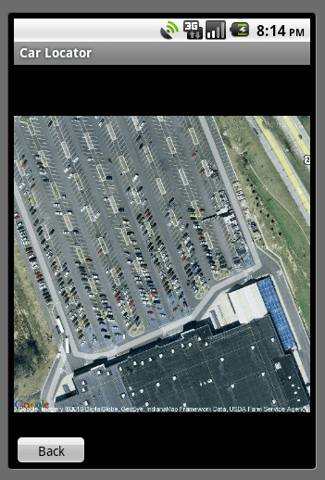
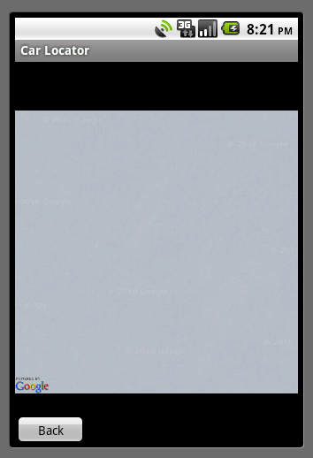
Location location location
The position of latitude and longitude in the URL have to be correct
Latitude comes first and the longitude follows
At latitude 40.458º N and longitude -86.9331º W is our local Wal-Mart
At latitude -86.9331º W and longitude 40.458º N are the barren plains of Antarctica

Slide 4
The next step
Have to now change ImageView to MapView – This creates a dynamic map that you can pan and zoom in and out of.
An API key is required. Requires accessing the Registry (or the Mac equivalent of it, if there is one).
Fix memory leaks (Already? YES!). It appears that the application is allocating memory that it is not de-allocating. Application had to force close 10-20% of the times when it was run multiple times.

