Slide 1
Week 8
Car Locator
Ahmad, Vinayak, Din
(AVD? Android Virtual Device)

Slide 2
MapView, not ImageView
Din: Changed codes from using ImageView (static maps) to MapView (dynamic maps)
- can zoom, pan, and center to GPS coordinates
Vinayak: Acquired Map API debug key
- means that we are able to use the Map API in the developmental phase, still need to get the Map API key to actually publish
<username>
For windows, use command prompt. Mac, use terminal.

Slide 3
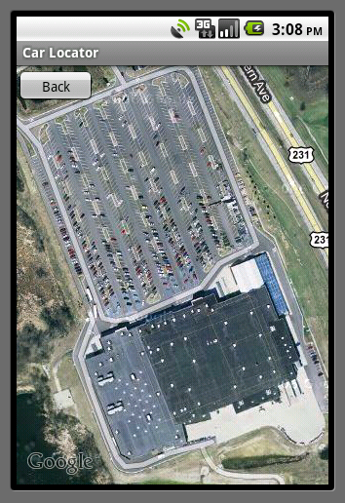
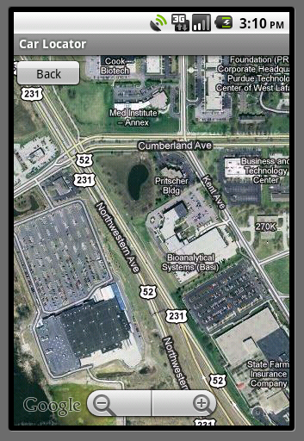
Intent on Activity
Some issues came when trying to go from an Activity to a MapActivity
Ahmad: Resolved

Slide 4
Milestones
Get a UI ready for the app – 9/21/2010
Look up resources on utilizing GPS using Java – 9/28/2010
Write code to acquire an image for the current location off of Google Maps – 10/12/2010
Write code to mark current position on phone – 10/26/2010
Bugs and fancy work – 11/16/2010
Write report/finishing touches on app – 12/07/2010

Slide 5
The next step
Markers to show car location, and probably extend to line markers for paths.
Fix memory leaks (again) because there are certain times that Eclipse just hates us. Sometimes creates random errors just to get our attention.
Creating DailyLog on Google Docs to keep track of team’s progress and backing up files to make sure there is something to revert to if something goes really bad (or if Eclipse hates us more).

