Slide 1
Click & Fix
9/15/2010
James Cui
Janam Jhaveri
Paul Mongold

Slide 2
The Idea
A fast and simple way to report campus issues
Picture taken of issue
Utilize GPS to automatically provide location data
User optionally gives comments
Send info through email or to a database
Purdue maintenance decides what to do
Examples:
Graffiti
Snow Removal
Water Drainage
Potholes/Sidewalks
Trees/Grass
Etc.

Slide 3
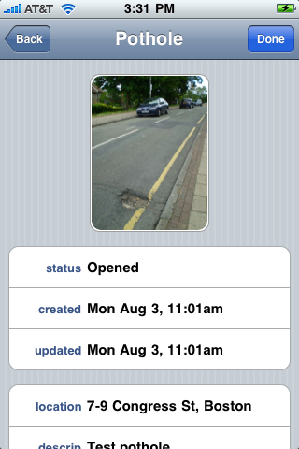
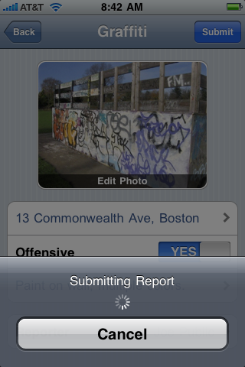
Citizen’s Connect

Slide 4
Camera
GPS
User
Comments
Purdue
Maintenance
Internet

Slide 5
Tasks for Next Week
James & Paul: Android basics
Android Developers (Android SDK, Eclipse)
O'Reilly Youtube Tutorial (1:24:48)
All: Find resources for camera, GPS, and data connection functionality
All: Look into where to send the information

Slide 6
Proposed Future Milestones
Due 10/13/10 (3 weeks)
Camera: Turn on/off, take/store picture
Due 10/27/10 (2 weeks)
GPS: Turn on/off, retrieve/store coordinates
Due 11/10/10 (2 week)
Transmission
Due 11/24/10 (2 weeks)
Text Entry & Additional Features
Due 12/8/10 (2 weeks)
Debugging & Finalizing

