Slide 1
Analysis of Precoding-based Intersession Network Coding and The Corresponding 3-Unicast Interference Alignment Scheme
Jaemin Han, Chih-Chun Wang*
Center for Wireless Systems and Applications
School of ECE, Purdue University
Ness B. Shroff
Department of ECE and CSE
The Ohio State University

Slide 2
Content
Pre-coding-based intersession Network Coding (NC)
Comparison to “An algebraic approach to network coding” [Koetter et al. IT03]
Existing results on 3-unicast Asymptotic Network Alignment (3-ANA) [Das et al. ISIT10], [Ramakrishnan et al. ALT10],
Under certain algebraic conditions, 3-ANA achieves rate
From algebraic to graph-theoretic conditions
New characterization theorems for general pre-coding-based NC.
Graph-theoretic conditions are easier to check (mostly polynomial time)!
Graph-theoretic characterizations for 3-ANA
Feasibility of 3-ANA New graph-theoretic conditions
Conclusion

Slide 3
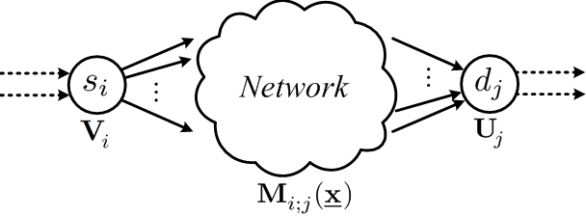
The Algebraic Framework of NC
An algebraic approach to network coding [Koetter et. al IT03]
Total network control:
Complete information at the receivers.
Algebraic conditions: The NC demands can be met if the code satisfies
(i) Full information along the principal path
(ii) Zero interference along the cross paths
Algebraic conditions are easy to verify but hard to solve. [Koetter et al. 03], [Lehman].
For special scenarios, we can develop graph-theoretic conditions.
Feasibility of a single multicast session rate is less than the min min-cut. [Li et al. 03]
Feasibility of 2 simple unicast sessions whether the critical cuts are properly placed.
Various capacity inner / outer bounds: [Harvey et al. IT06], [Yan et al. IT06], etc.
Hard to control what happens inside the network.
Precoding
Decoding
Channel
The local coding kernel:

Slide 4
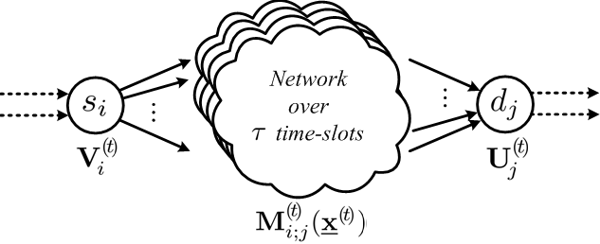
INC : New Framework
: vertical concatenation of precoding
: horizontal concatenation of decoding
: block diagonalization of channels
Precoding-based Framework
Distributed, partial control: Design , leave the network kernels random.
Complete information at the receivers.
Algebraic conditions
(i) Full information along the principal path
(ii) Zero interference along the cross paths
Several design choices
Coding across multiple time slots.
Strictly causal vs. Causal vs. Non-causal. Also time-invariant versus time-varying.
Again, easy to verify but hard to solve.
The only known special scenario is the single multicast setting.
Precoding
Decoding
Precoding
Channel
Channel
If we relax the “complete info. at Rx” condition,
then we have the non-coherent random lin. NC.
[Koetter, Kschischang 08].

Slide 5
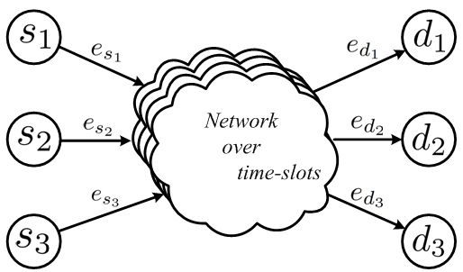
Existing 3-Unicast ANA
A specific example: 3-unicast Asymptotic Network Alignment (ANA) by [Das et al. ISIT10], [Ramakrishnan et al. ALT10]
Consider a simple 3-unicast network.
Three coexisting sessions
and
and
Fully interfering: can be reached from .
Time-invariant topology
Application of “Interference Alignment” devised in wireless channel [Cadambe et. al IT08] to 3-unicast stable DAG
The goal is to achieve rate vector

Slide 6
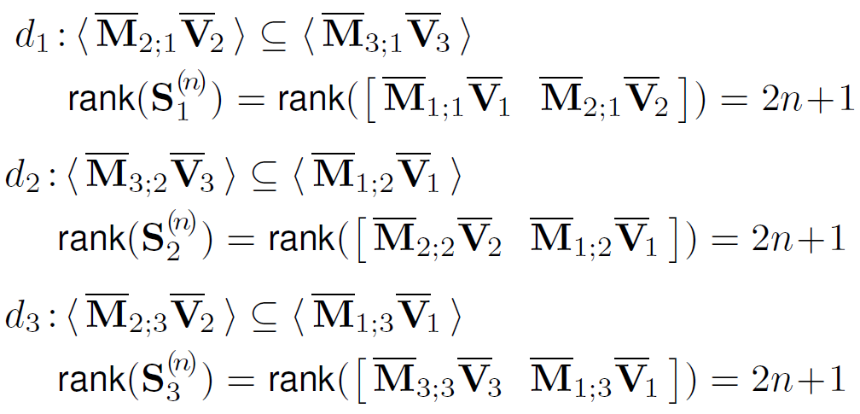
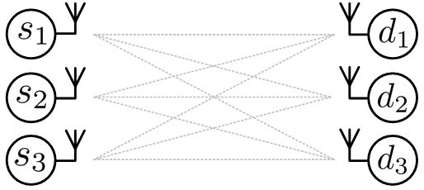
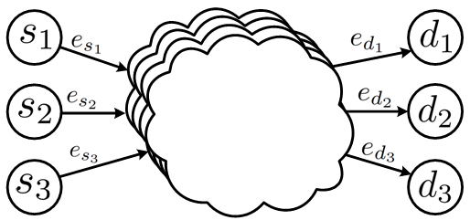
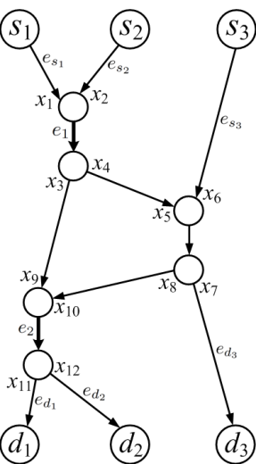
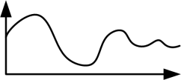
3-Unicast ANA
3-unicast Asymptotic Network Alignment (ANA)
Application of “Interference Alignment” achieving for integer
The channel gain polynomial:
Precoding design of IA [Cadambe et. al IT08] :
Define
Let
is the vertical concatenation of where
Non-causal & time-invariant design with the Vandermonde form
Feasibility conditions
Precoding matrices must satisfy:
An example network
with
must satisfy :
Wireless
Interference
Channel
3-unicast
ANA
w.h.p.
channel
w.h.p.
Relationships between
channel gains and network topology
gains
(1)-(4) hold w.h.p.
[Cadambe et. al IT08]
w.h.p.
Not easy to solve!

Slide 7
Some Further Notation
Some useful algebraic notation
A set of polynomials are linearly dependent if for some not-all-zero coefficients , .
if and are linearly dependent.
if and are linearly independent.
The graph-theoretic condition:
If the edge-cut value between is one, then use 1-EC to denote the collection of all 1-edge cuts separating
If the edge-cut value between is not one, then define
1-EC

Slide 8
Main Results
State-of-the-art Knowledge [Ramakrishnan et al. ALT10] :
New Graph-Theoretic Characterizations
must satisfy :
Easy to solve!
Main Result #1
Why this is not enough?
Hard to solve!
is still hard to check
Conjecture remains open
even for
with high prob.
except all zeros
Hard to solve!
Easily derived
by Theorem 1
with high prob.
Conjectured,
verified by simulations
Easily derived by Theorem 1
Main Result #2
When ,
with high prob.
Prove the conjecture for
the simplest case n=1.
&
Easily derived by Corollary 1
Easy to solve!

Slide 9
The Subgraph Property
Let be the network variables present in a subgraph
be the collection of all channel gains present in
Consider two arbitrary polynomial functions and taking the same number of arguments and producing a value.
Similar flavor to the result of [Koetter et. al IT03] for the single multicast.
However, the problem persists. Finding a subgraph is still hard since we do not have any graph-theoretic characterization as guidance.

Slide 10
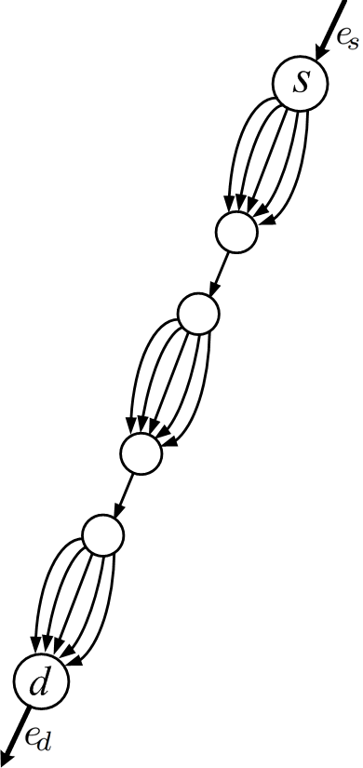
The Role of 1-Edge Cuts
That is, the 1-edge cuts decompose the channel gain as a
product of multiple irreducible components.

Slide 11
The GTC of L ≠ R
Proposition 1
such that & satisfies
Proof of
Recall
Step 1: WLOG, consider and
Step 2: Establish that is upstream of . Intuitively,
and
Step 3: Examine L(x) and R(x) saparately.

Slide 12
The GTC of L ≠ R
Proposition 1
such that & satisfies
Proof of
Recall
Step 1: WLOG, consider and
Step 2: Establish that is upstream of . Intuitively,
and
Step 3: Examine L(x) and R(x) saparately.

Slide 13
The GTC of L ≠ R
Proposition 1
such that & satisfies
Proof of
Recall
Step 1: WLOG, consider and
Step 2: Establish that is upstream of . Intuitively,
and
Step 3: Examine L(x) and R(x) saparately.

Slide 14
The GTC of L ≠ R
Proposition 1
such that & satisfies
Proof of
Recall
Step 1: WLOG, consider and
Step 2: Establish that is upstream of . Intuitively,
and
Step 3: Examine L(x) and R(x) saparately.

Slide 15
The GTC of L ≠ R
Proposition 1
such that & satisfies
Proof of
Recall
Step 1: WLOG, consider and
Step 2: Establish that is upstream of . Intuitively,
and
Step 3: Examine L(x) and R(x) saparately.

Slide 16
The GTC of L ≠ R
Proposition 1
such that & satisfies
Proof of
Recall
Step 1: WLOG, consider and
Step 2: Establish that is upstream of . Intuitively,
and
Step 3: Examine L(x) and R(x) saparately.

Slide 17
The GTC of L ≠ R
Proposition 1
such that & satisfies
Proof of
Now we start from
Part 1
Cannot be part of and
Cannot be part of and
All and are non-empty.

Slide 18
The GTC of L ≠ R
Proposition 1
such that & satisfies
Proof of
Now we start from
Part 2: If , say .
For the following, we prove
Suppose there exists a path not using
(colored by ). Then we can prove
that path will touch neither nor
. However, if we consider the current
subgraph, we clearly have and
. This
contradicts the subgraph property
in Theorem 2.
Part of but not part of nor
Must be part of

Slide 19
The GTC of L ≠ R
Proposition 1
such that & satisfies
Proof of
Part 3:
In this case, we can show graphic-theoretically (no need to use algebraic arguments) that
and . The proof is thus complete.
Intuition: when the 1-edge-cuts overlap with each other sufficiently
(when ), then inevitably we will have the overlap
between any pairs of and and any pairs of and .

Slide 20
Main Results
New Graph-Theoretic Characterizations
must satisfy :
Easy to solve!
Main Result #1
Hard to solve!
with high prob.
except all zeros
Hard to solve!
Easily derived
by Theorem 1
with high prob.
Conjectured,
verified by simulations
Easily derived by Theorem 1
Main Result #2
When ,
with high prob.
Prove the conjecture for
the simplest case n=1.
&
Easily derived by Corollary 1
Easy to solve!

Slide 21
The Remaining Task
The challenges of proving Main Result #2:
L ≠ R is the linear independence condition between two polynomials.
The Main Result #2 is regarding the linear independence among 2n+1 polynomials. Too many choices of the coefficients.
On the other hand, the graph-theoretic properties greatly help us simplify the problem.
We have proven the case when n=1.

Slide 22
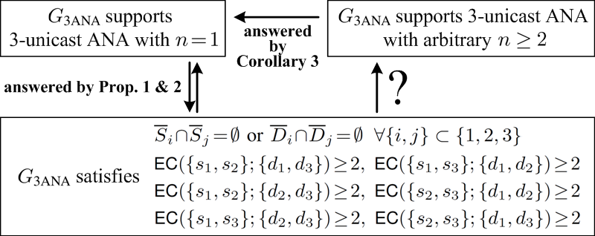
Summary of The Results
Current Understanding of 3-unicast ANA Graph-Theoretic Characterizations
with high prob.
with high prob.
Algebraic
with high prob.
Graph-Theoretic
Conclusion
Intersession NC : Precoding-based Framework
Theoretic DAG analysis of precoding-based solution on DAG.
Special example of Precoding-based Framework : 3-uincast ANA
Graph-theoretic characterizations that can be easily checked.

Slide 23
Future Work
Obviously, the graph-theoretic results for n>1
With the graph-theoretic condition, we can answer questions in a more definite way:
Whether / how much throughput loss is induced by a 3-ANA scheme
More general networks other than 3-ANA?

Slide 24
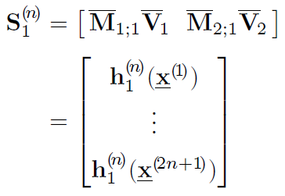
From Det≠0 To Lin. Indep.
is row-invariant where
Theorem 1: The set of polynomials are linearly independent if and only if .
Sketch of the proof: When are linearly dependent, .
When for all , we fix the values of to ,
the cofactors will give us the coefficient in the linear sum.
[1] + [2] [1] + [Cond. 1]
[2.1] [Cond. 1]
[Cond. 1] + [1] [2.1]
must satisfy :
[2.1]
[Cond. 1] proposed by [Ramakrishnan 10]
By Theorem 1
is
except all zeros
with high prob.
L. I. on

